Slide 1
Introduction to Sahaja Yoga
Grade 1, Nirmala Vishwa Vidya Peetham (Home School), Dunwoody GA (Dekalb County)

Slide 2
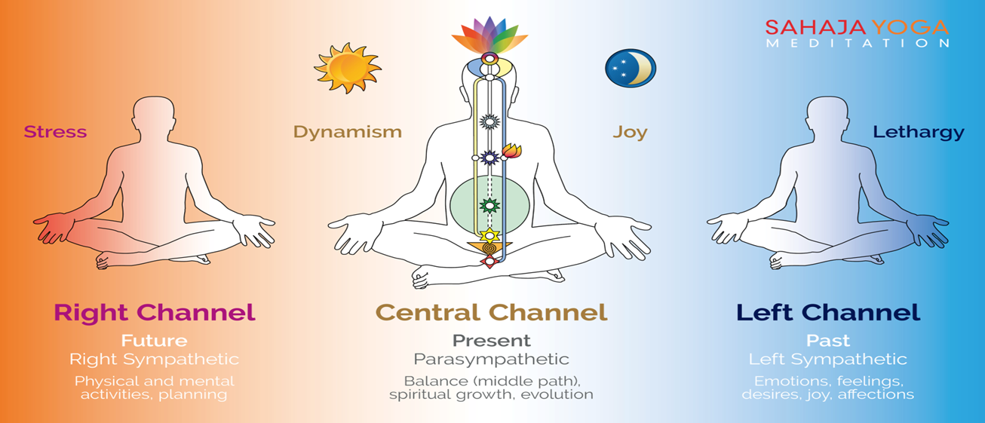
Sahaja Yoga:
Sahaja Yoga includes union with God. Sahaja Yoga includes Kundalini. In Kundalini, if will are balanced we will get Self-Realization and feel the something cool on top of oud head. Sahaja Yoga includes seven chakras: Mooladhara, Swadhisthana, Nabhi Void, Anahata, Vishuddhi, Agnya, and Sahastrara. Shri Mataji taught Sahaja Yoga in 1970.

Slide 3
Benefits:
Sahaja yoga helps us to be good, helps to do good things, it will cure physical or mental problems, gives us good health, etc. and does help us.

Slide 4
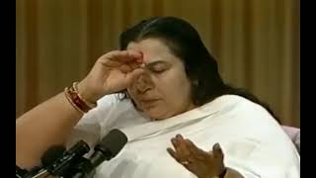
How to get the Expereince
10 minutes talk by Shri Mataji

Slide 5
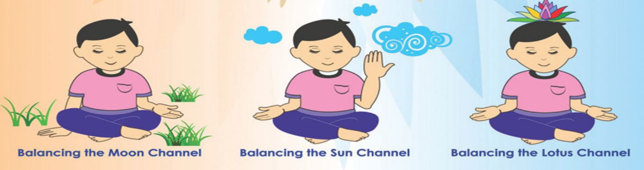
Daily meditation
You need to balance all the 3 channels: the Left channel, the Right channel, and the Central channel. That is important because, you can take away all your bad negativities. To balance all 3 channels, you need to do like in this image:
Mother, please balance my Left channel Mother, please balance my Right channel Mother, please keep me in the present (balancing the Central channel)

Slide 6
Collective meditation (~ References)
Collective meditation is important because you can learn so many new things like how to do Pujas, etc.
To go to the collective meditation in Atlanta GA, you can go to 1122 Cambridge Square to the 1st floor, and you can search other centers (e.g. Sahaja Yoga International School, Canajoharie is in New York when we search it in Google Maps)
For more information, visit:
Sahajayoga.org
freemeditation.com

